Slide 1
Database Concepts

Slide 2
Topics Covered
Introduction to DBMS
Why we need DBMS ?
Areas where DBMS are used.
Three level of abstraction(conceptual, physical and logical)
Schema and Instance
Data Models : Introduction to Hierarchical Model, Network and Relational Model, Semi-structured data model
Database client-server model

Slide 3
Introduction to DBMS
Data : facts or information in the form of text, video, images, etc.
Database : collection of inter-related data which helps in efficient retrieval, insertion and deletion of data.
Database Management System : technology for creating and managing databases.
DBMS is a software tool to organize (create, retrieve, update and manage) data in a database.
Eg : Oracle, MySQL, MongoDB, Cassandra, ..etc

Slide 4
Why use DBMS ?
Data independence: Application programs should be as free or independent as possible from details of data representation and storage.
Efficient data access: DBMS utilizes a mixture of sophisticated concepts and techniques for storing and retrieving data competently.
Data integrity and security: If data is accessed through the DBMS, the DBMS can enforce integrity constraints on the data.
Data administration: When several users share the data, integrating the administration of data can offer major improvements.

Slide 5
DB Management Terminologies
Redundancy of data: Data is said to be redundant if same data is copied at many places.
Inconsistency of Data: Data is said to be inconsistent if multiple copies of same data does not match with each other.
Unauthorized Access: File System may lead to unauthorized access to data.
Concurrent Access: The access of same data by multiple users at same time is known as concurrency.
Backup and Recovery: backup and recovery of data if a Data is lost or corrupted.

Slide 6
Areas where DBMS are used
Airlines: reservations, schedules, etc
Telecom: calls made, customer details, network usage, etc
Universities: registration, results, grades, etc
Sales: products, purchases, customers, etc
Banking: all transactions etc

Slide 7
DBMS Database Models
Database model defines the logical design and structure of a database
defines the relationships and constraints that determine how data can be stored and accessed
While the Relational Model is the most widely used database model, there are other models too:
Hierarchical Model
Network Model
Relational Model

Slide 8
Hierarchical Model
Organises data into a tree-like-structure
A single root, to which all the other data is linked. The heirarchy starts from the Root data, and expands like a tree, adding child nodes to the parent nodes.
Model efficiently describes many real-world relationships like index of a book, recipes etc.

Slide 9
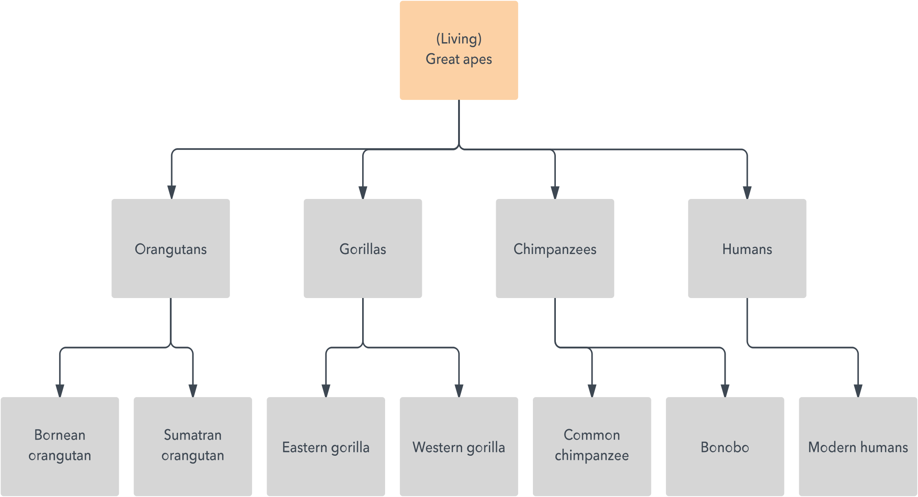
Hierarchical Model

Slide 10
Network Model
Organises data a more like a graph, and are allowed to have more than one parent node.
data is more related as more relationships are established in this database model.
many-to-many relationships between linked records

Slide 11
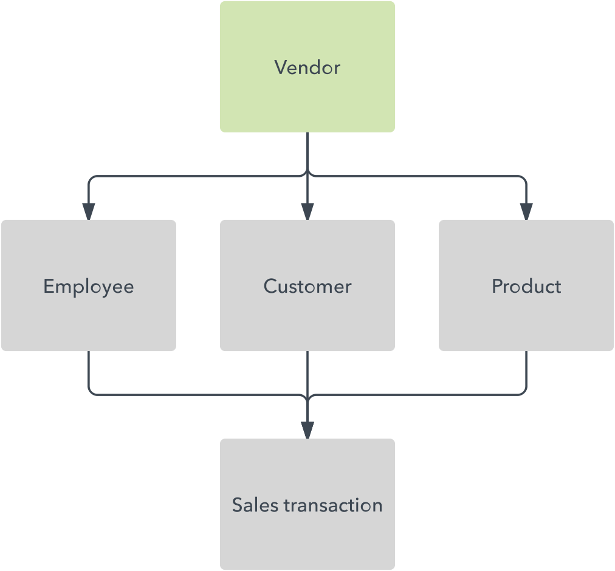
Network Model

Slide 12
Relational Model
Organize data into tables, also known as relations, each of which consists of columns and rows.
Each column lists an attribute of the entity in question, such as price, zip code, or birth date

Slide 13
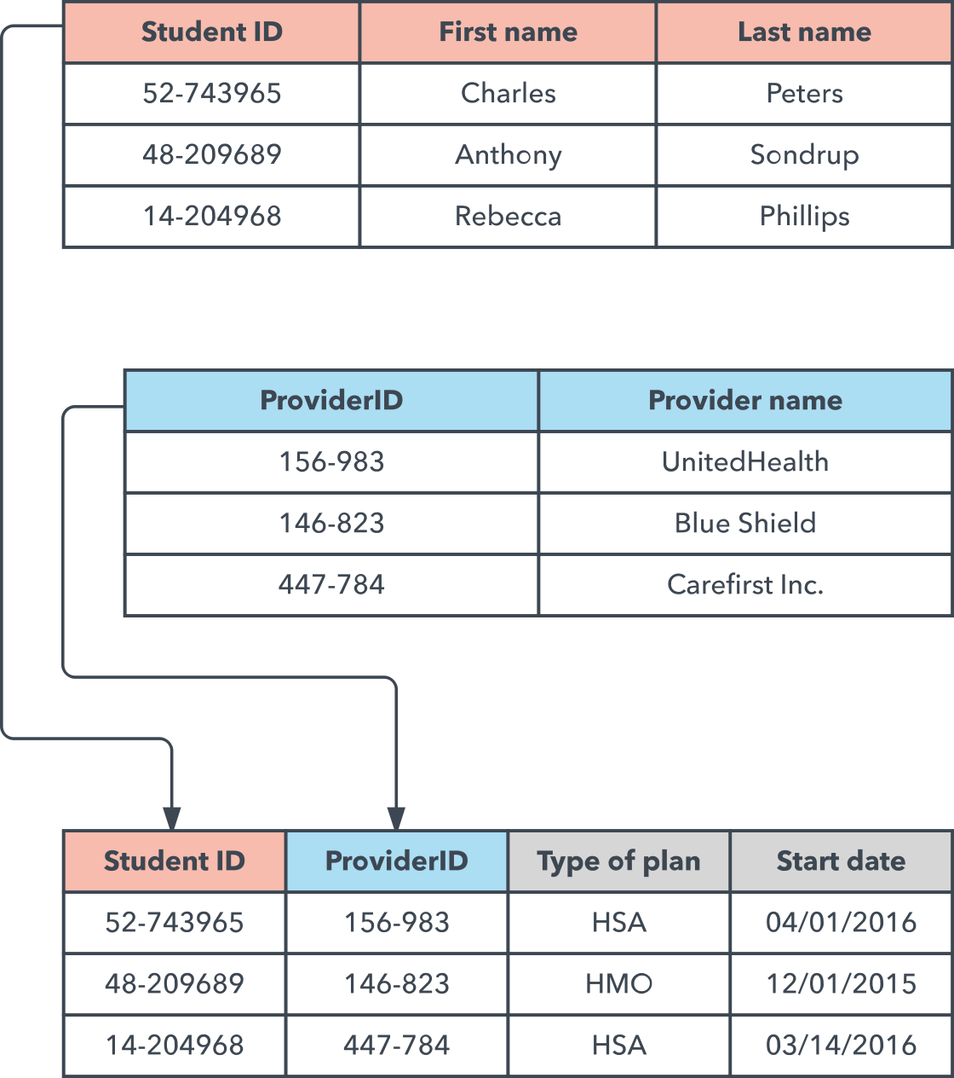
Relational Model

Slide 14
Three level of data modeling
Conceptual: This Data Model defines WHAT the system contains. The purpose is to organize, scope and define business concepts and rules.
Logical: Defines HOW the system should be implemented regardless of the DBMS. The purpose is to developed technical map of rules and data structures.
Physical: This Data Model describes HOW the system will be implemented using a specific DBMS system. The purpose is actual implementation of the database.

Slide 15
Conceptual data model
A conceptual data model identifies the highest-level relationships between the different entities. Features of conceptual data model include:
Includes the important entities and the relationships among them.
No attribute is specified.
No primary key is specified.

Slide 16
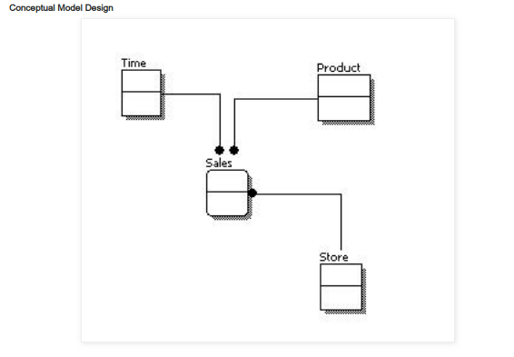
Data modelling

Slide 17
Logical data model
A logical data model describes the data in as much detail as possible, without regard to how they will be physical implemented in the database. Features of a logical data model include:
Includes all entities and relationships among them.
All attributes for each entity are specified.
The primary key for each entity is specified.
Foreign keys (keys identifying the relationship between different entities) are specified.
Normalization occurs at this level.

Slide 18
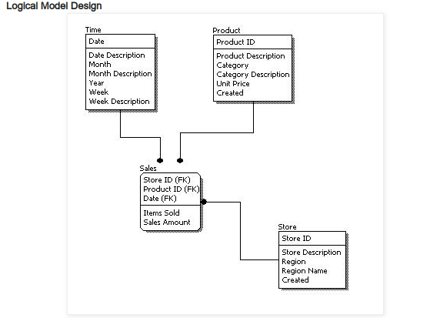
Data modelling

Slide 19
Physical data model
Physical data model represents how the model will be built in the database. A physical database model shows all table structures, including column name, column data type, column constraints, primary key, foreign key, and relationships between tables. Features of a physical data model include:
Specification all tables and columns.
Foreign keys are used to identify relationships between tables.
Physical considerations may cause the physical data model to be quite different from the logical data model.
Physical data model will be different for different RDBMS. For example, data type for a column may be different between Oracle, DB2 etc.

Slide 20
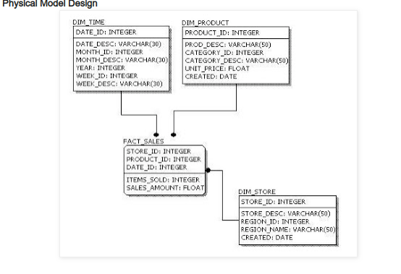
Data modelling

Slide 21
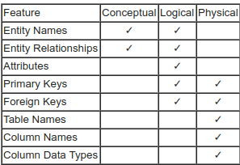
Data modelling

